Slide 1
Cinema ticket reservation

Slide 2
Presented by
GNANAVARSHA P (CSA2140)
JAYASHREE V S (CSA2151)
KEERTHANA S (CSA2160)
KIRUTHIKA G (CSA2163)

Slide 3

https://onlinegdb.com/ubjmf9ffm

Slide 4
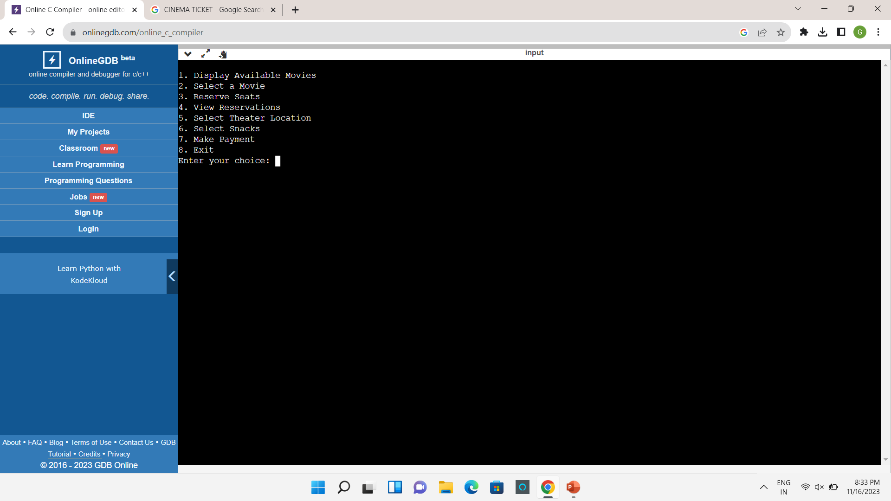
Output:

Slide 5
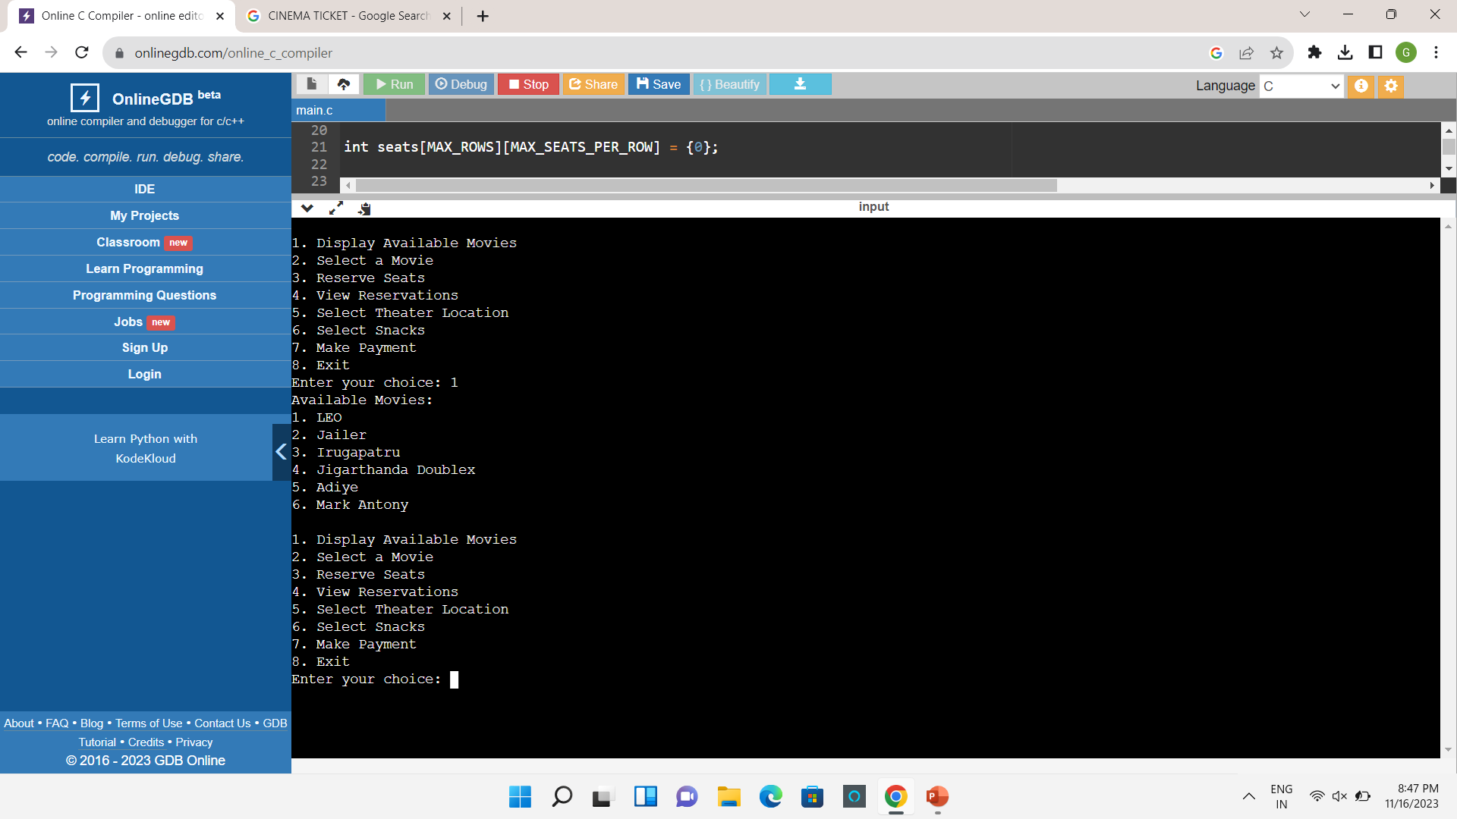
Choice 1 is for displaying the available movies

Slide 6
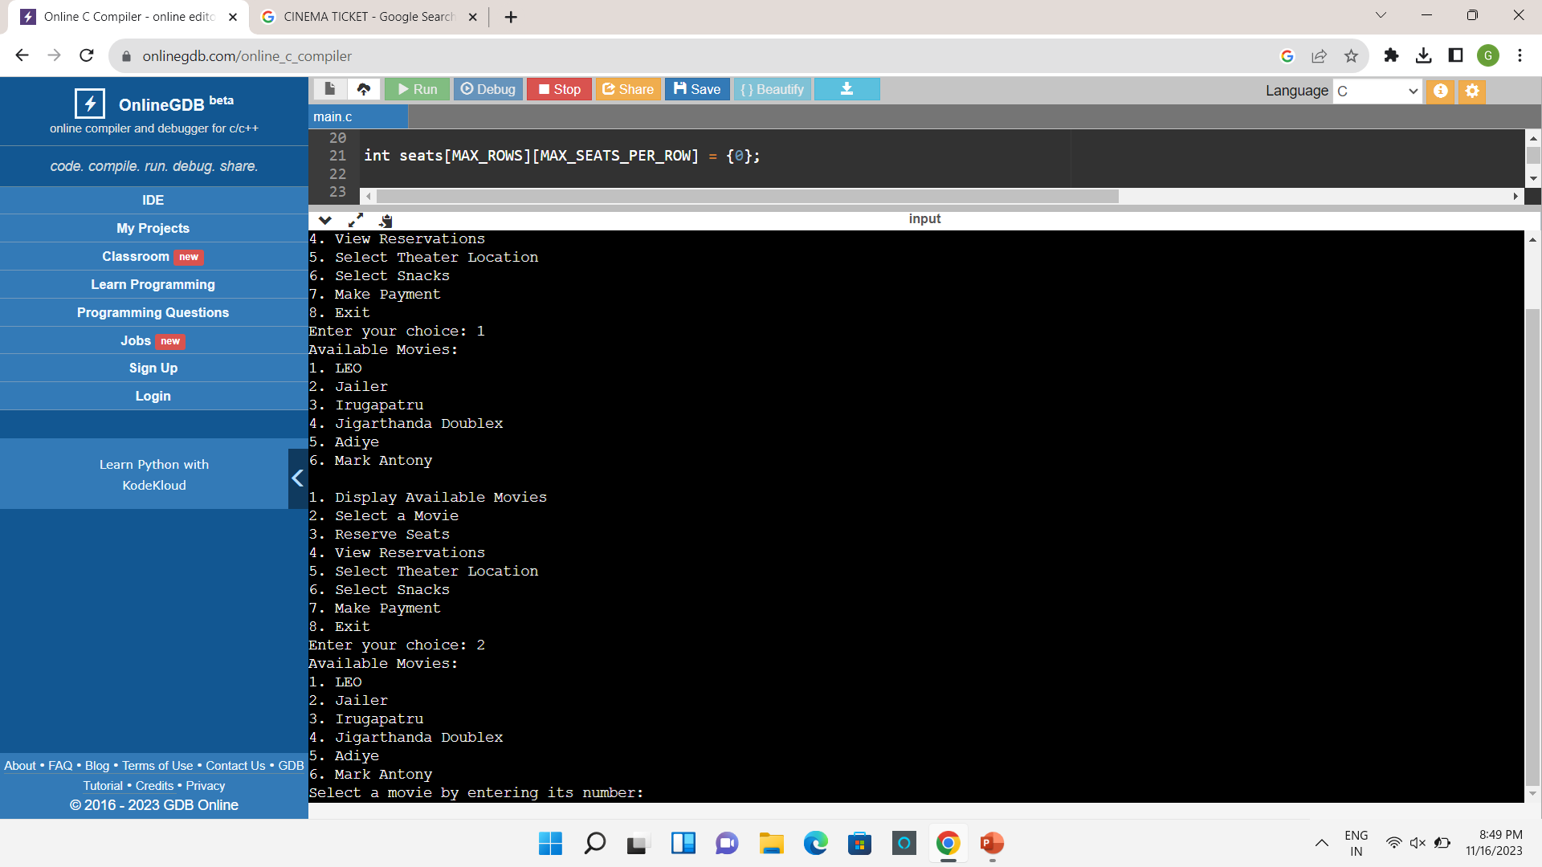
Choice 2 is to Select the Movie.

Slide 7

We can select the movie by entering its number .If we enter a number then the program will display the available seats in the theatre for the corresponding movie.

Slide 8

Choice 3 is used to Reserve the seats for the Movie.

Slide 9
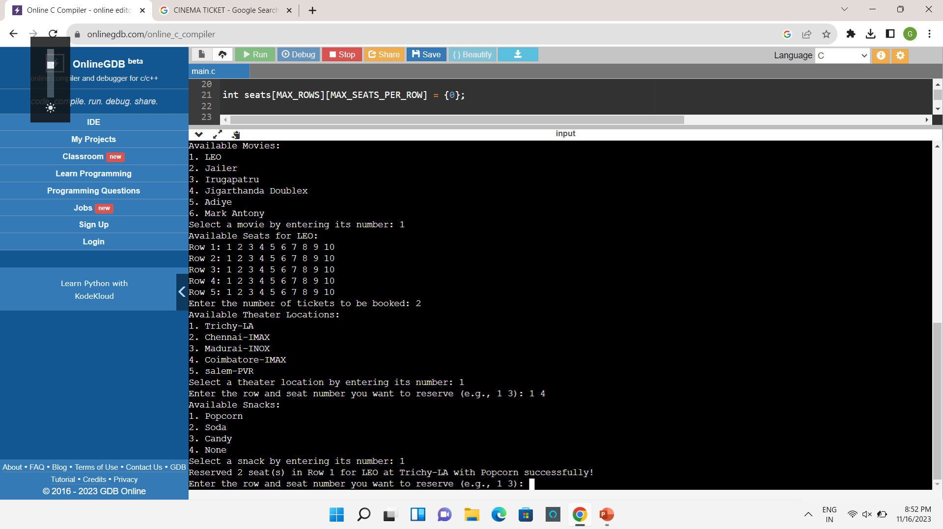
We reserve the ticket by entering the movie number .Then we have to enter no. of tickets to be book. Next we have to select the theatre location and then if we want we can select the snacks.If we enter all those things the output will display as below.

Slide 10
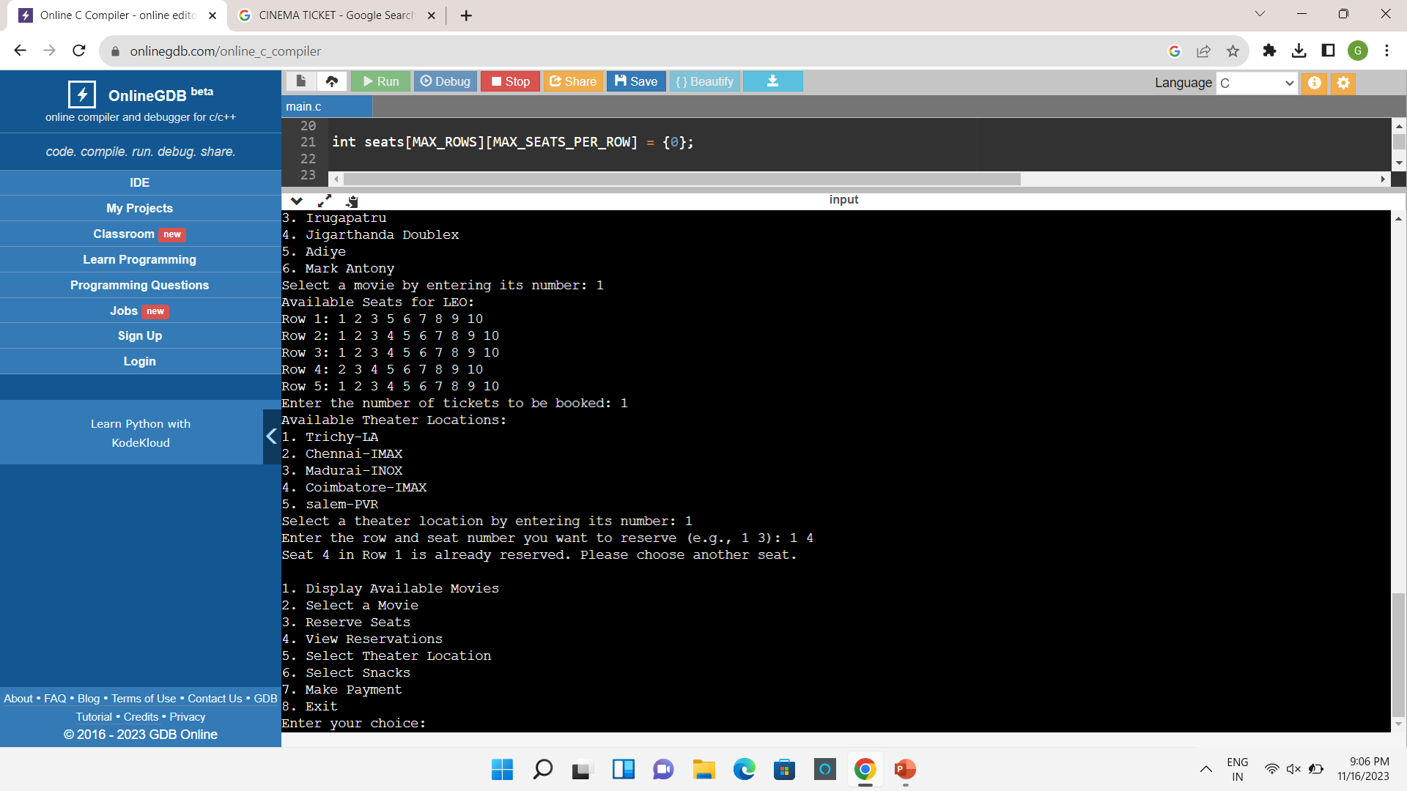
If we again enter the same seat for same movie to reserve the output will be displayed as below.

Slide 11
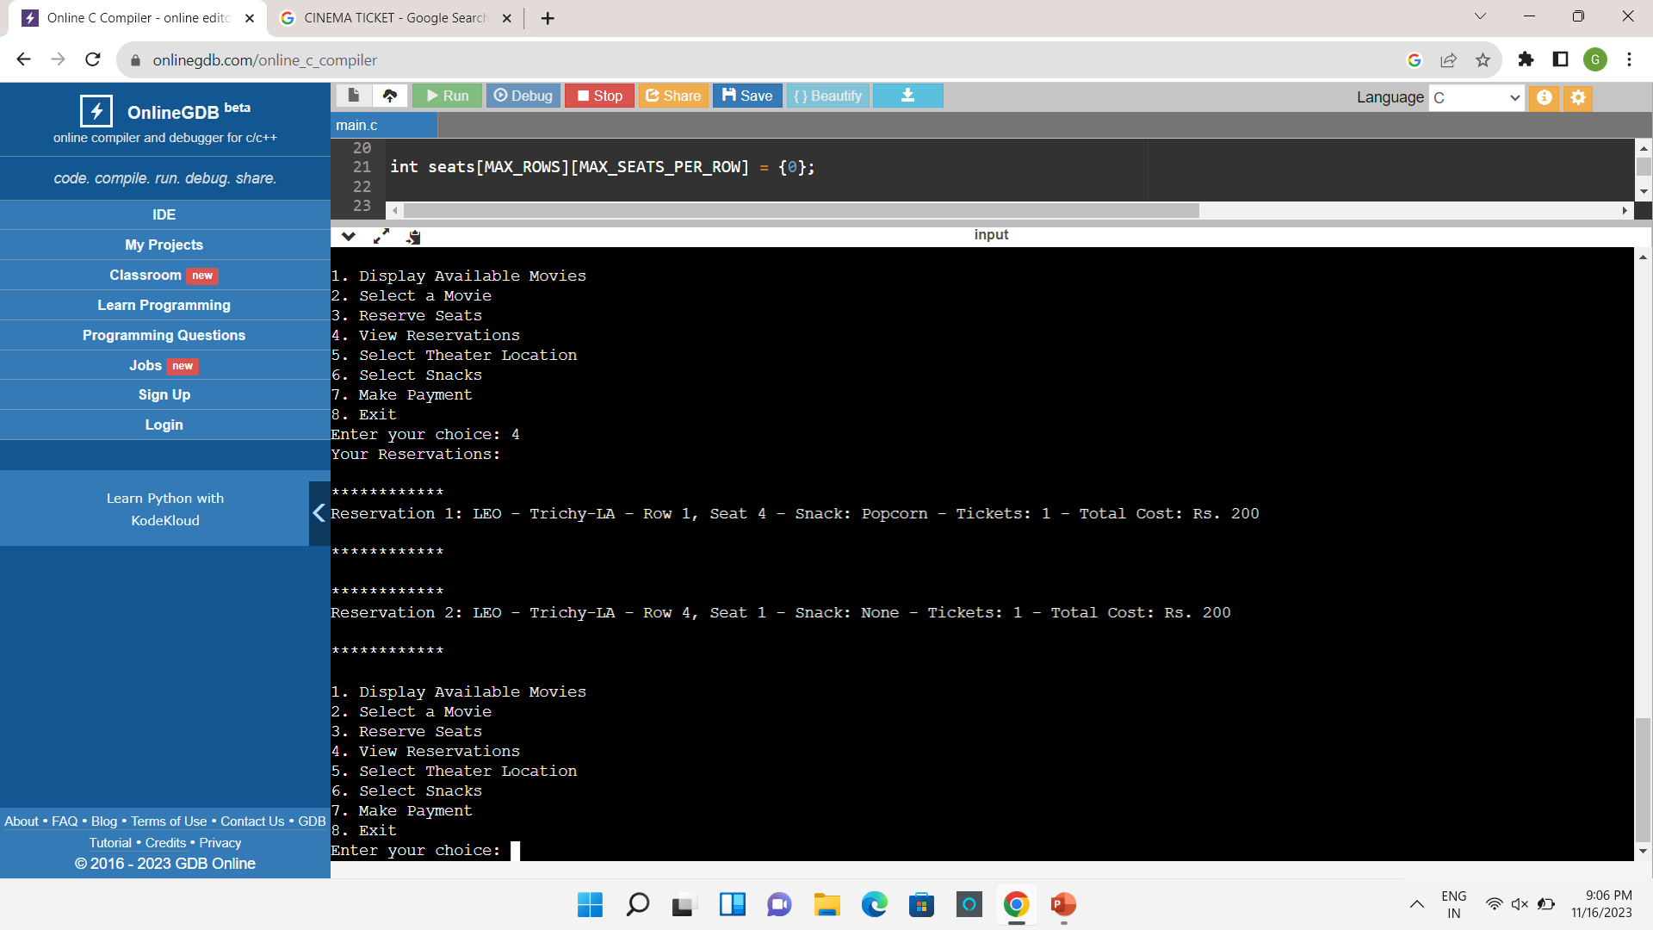
Choice 4 is used to view the reservation that is done so for.

Slide 12
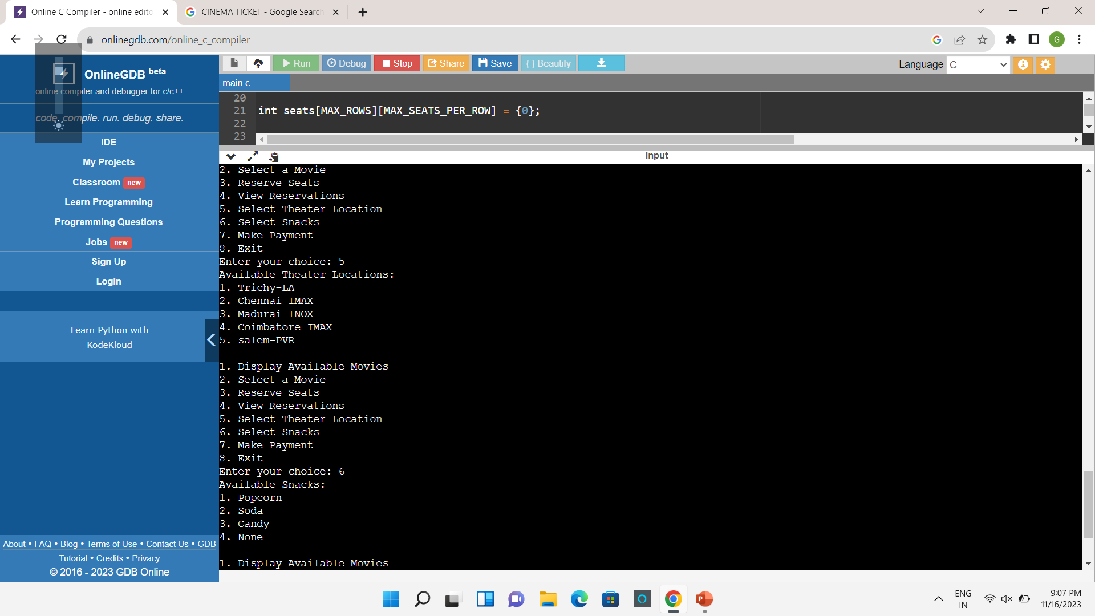
Choice 5 is used to display the theatre location .Choice 6 is used to display the snacks that are available in the theatre.

Slide 13

Choice 7 is used to make the payment for reserving the ticket.

Slide 14
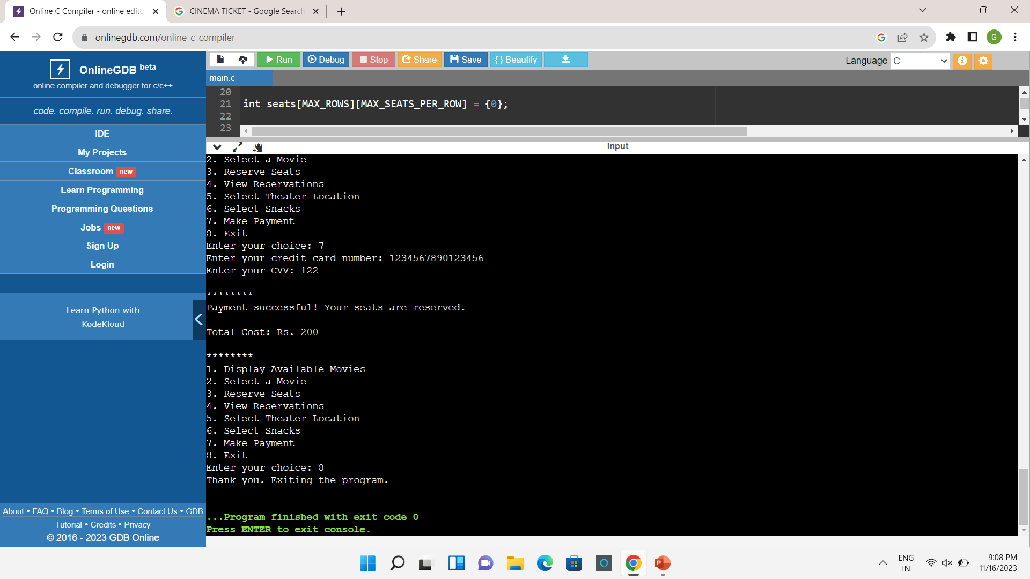
Choice 8 is used for exiting from the program.

Slide 15
THANK YOU

